Slide 1


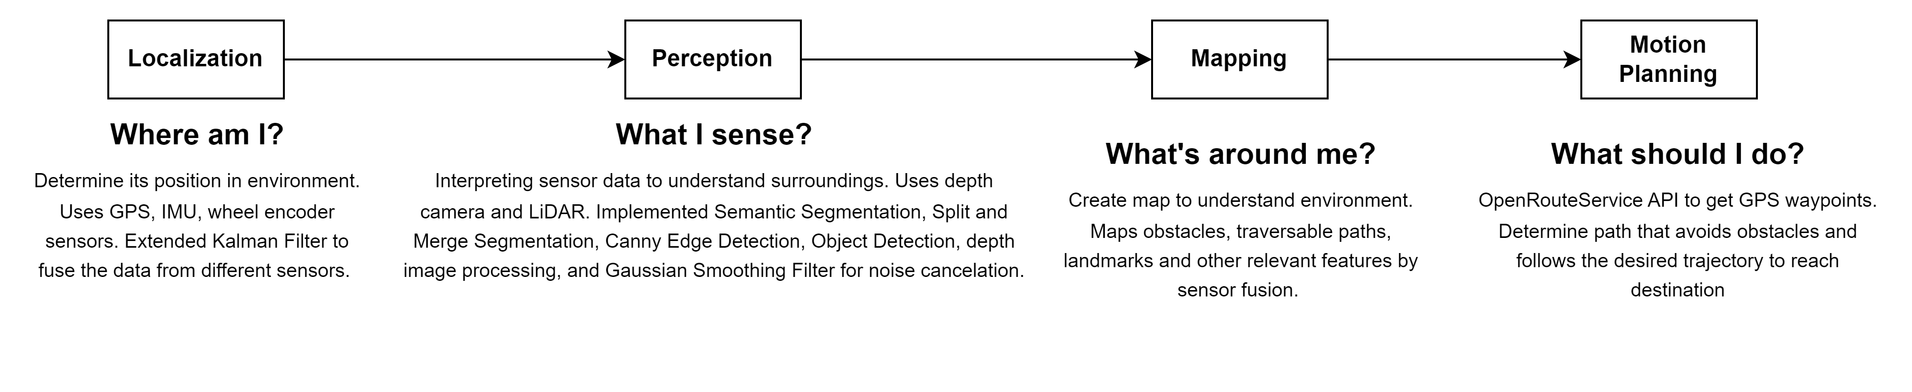
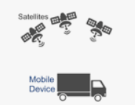
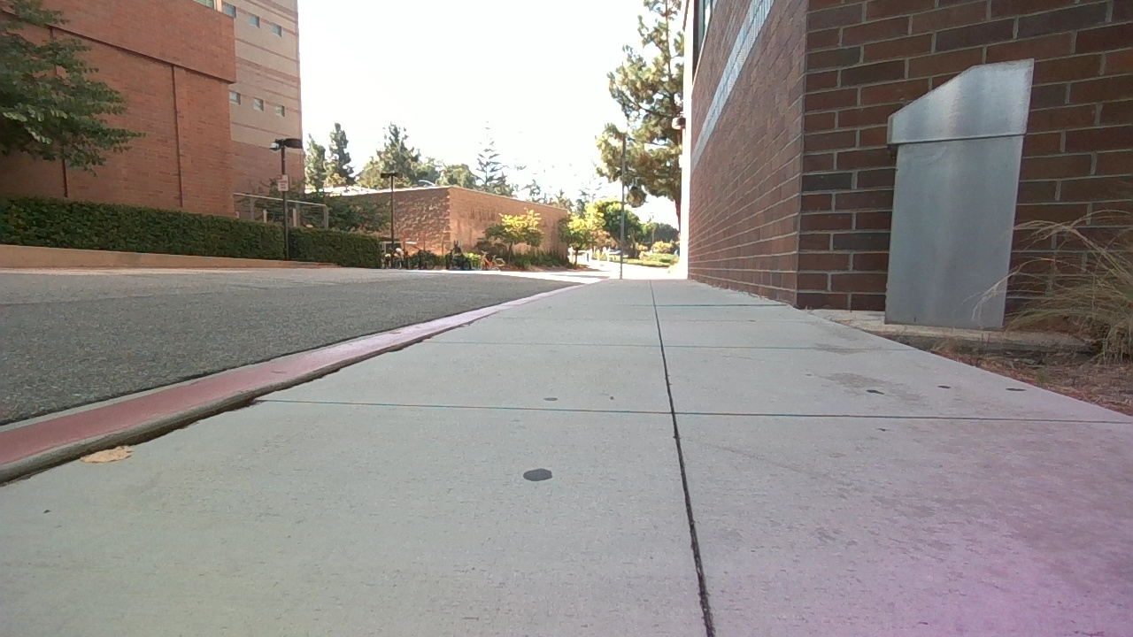
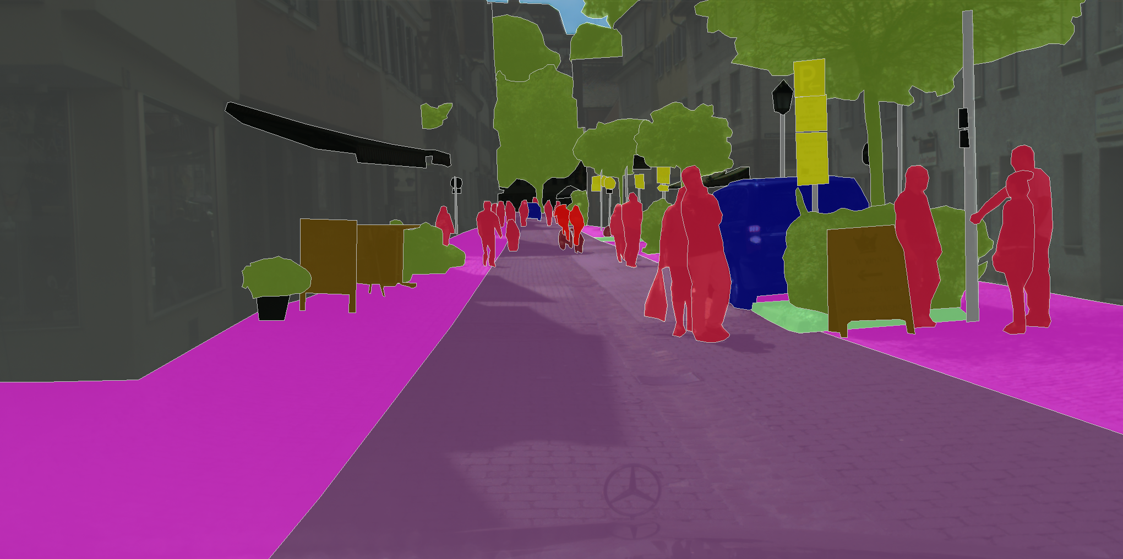
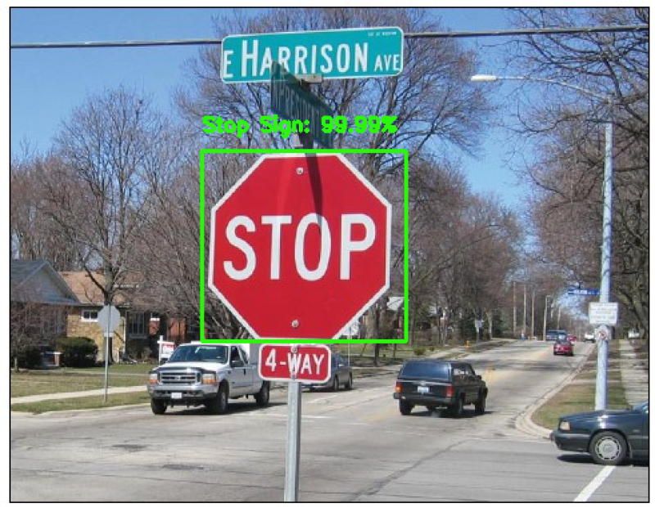
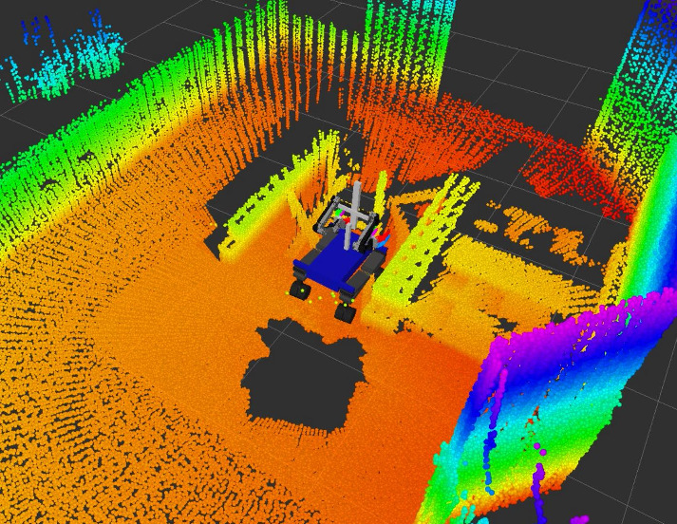
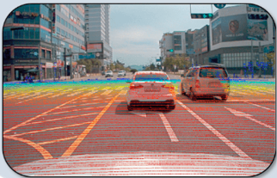

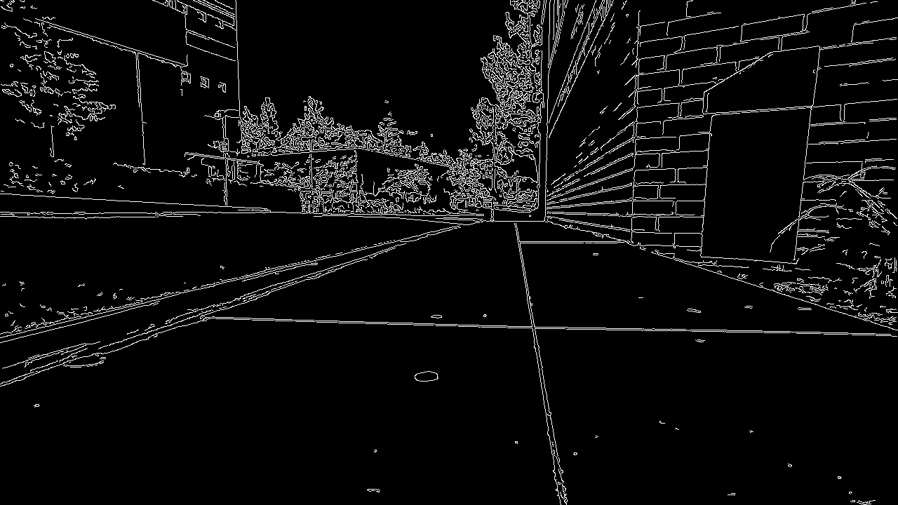
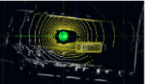
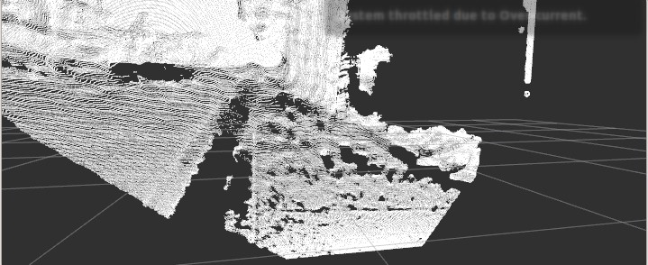
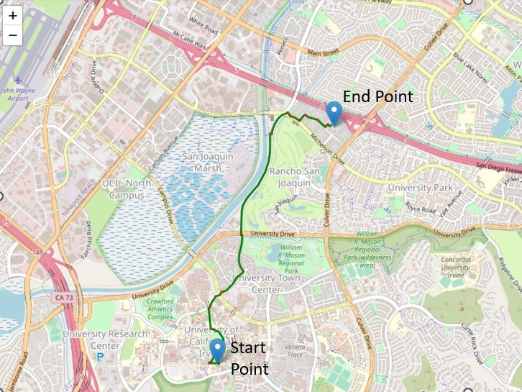
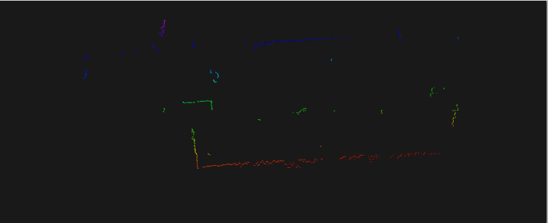
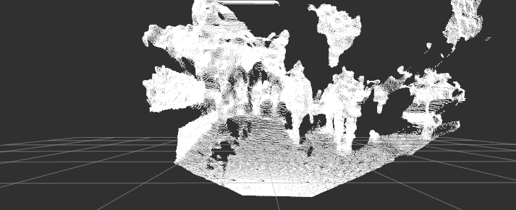
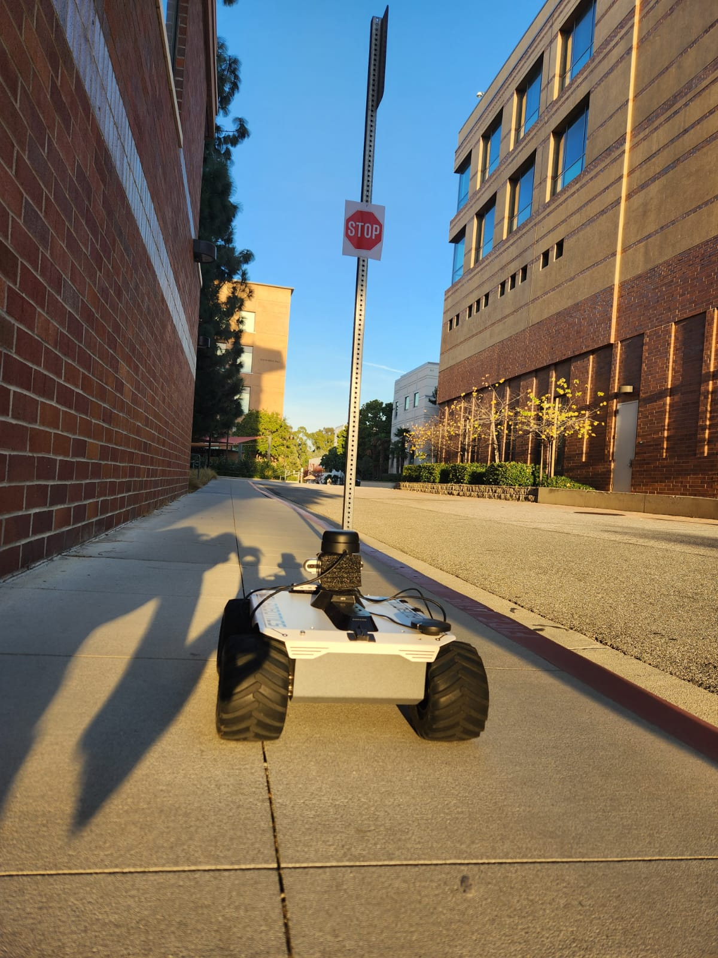
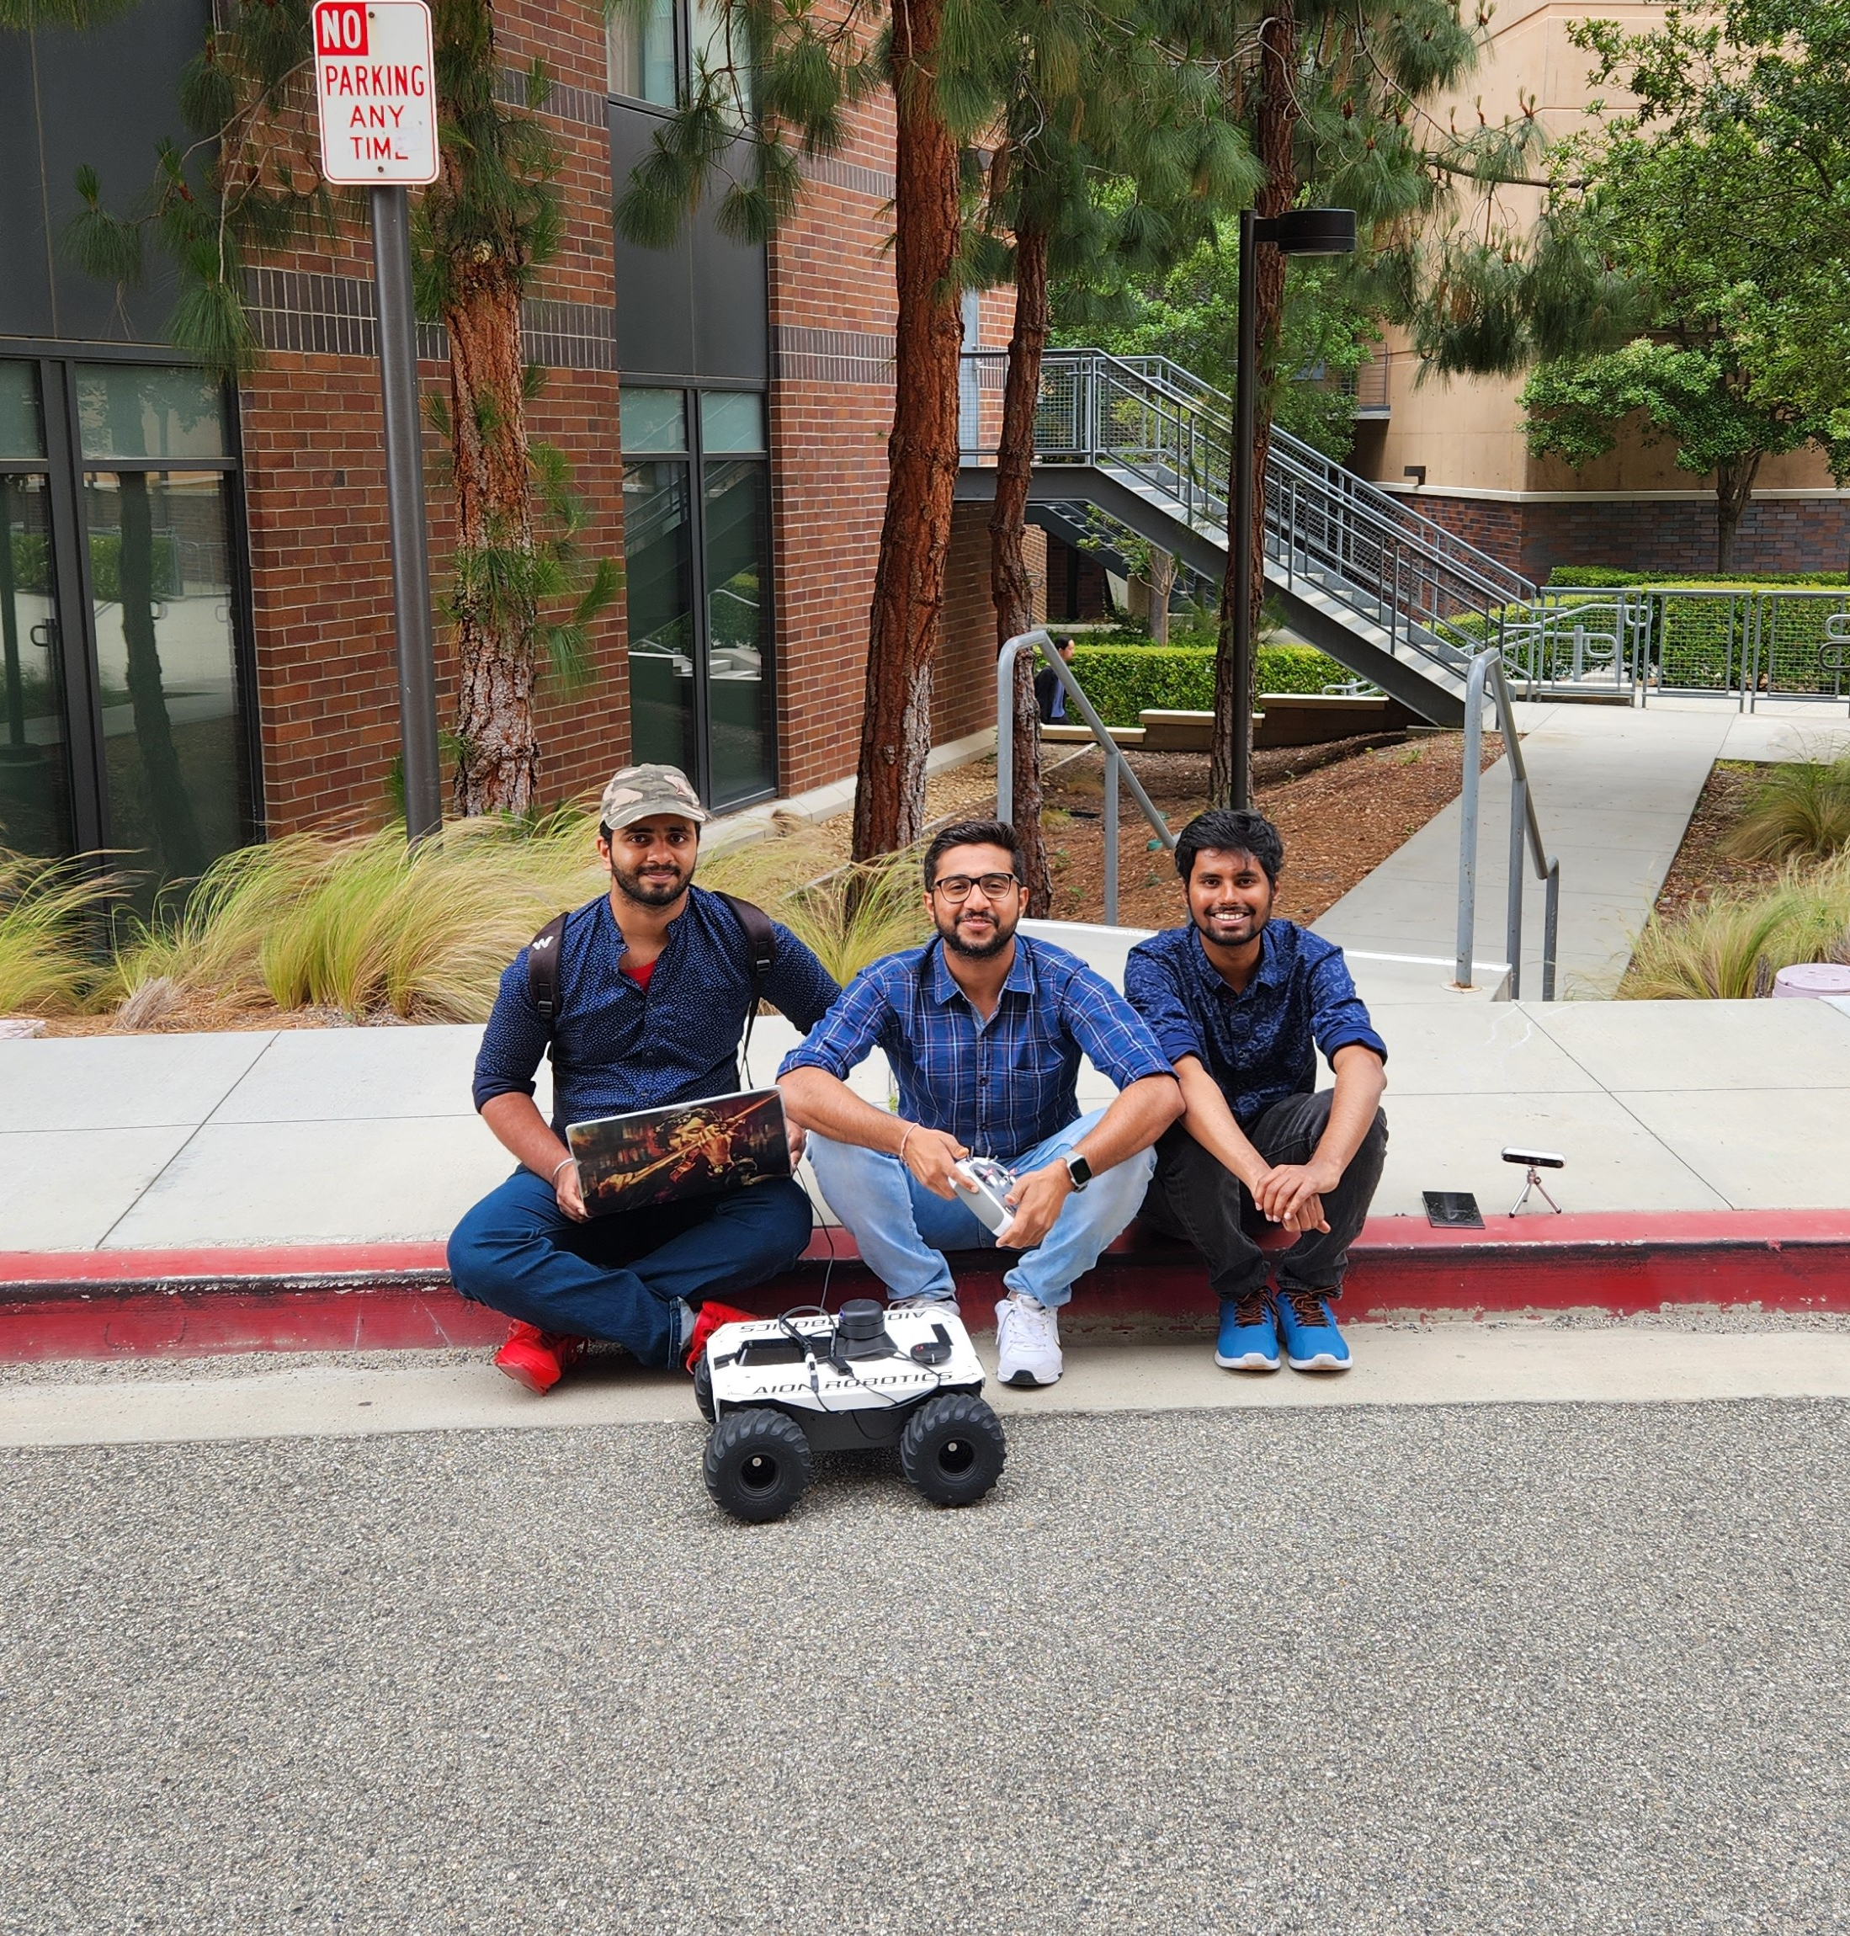
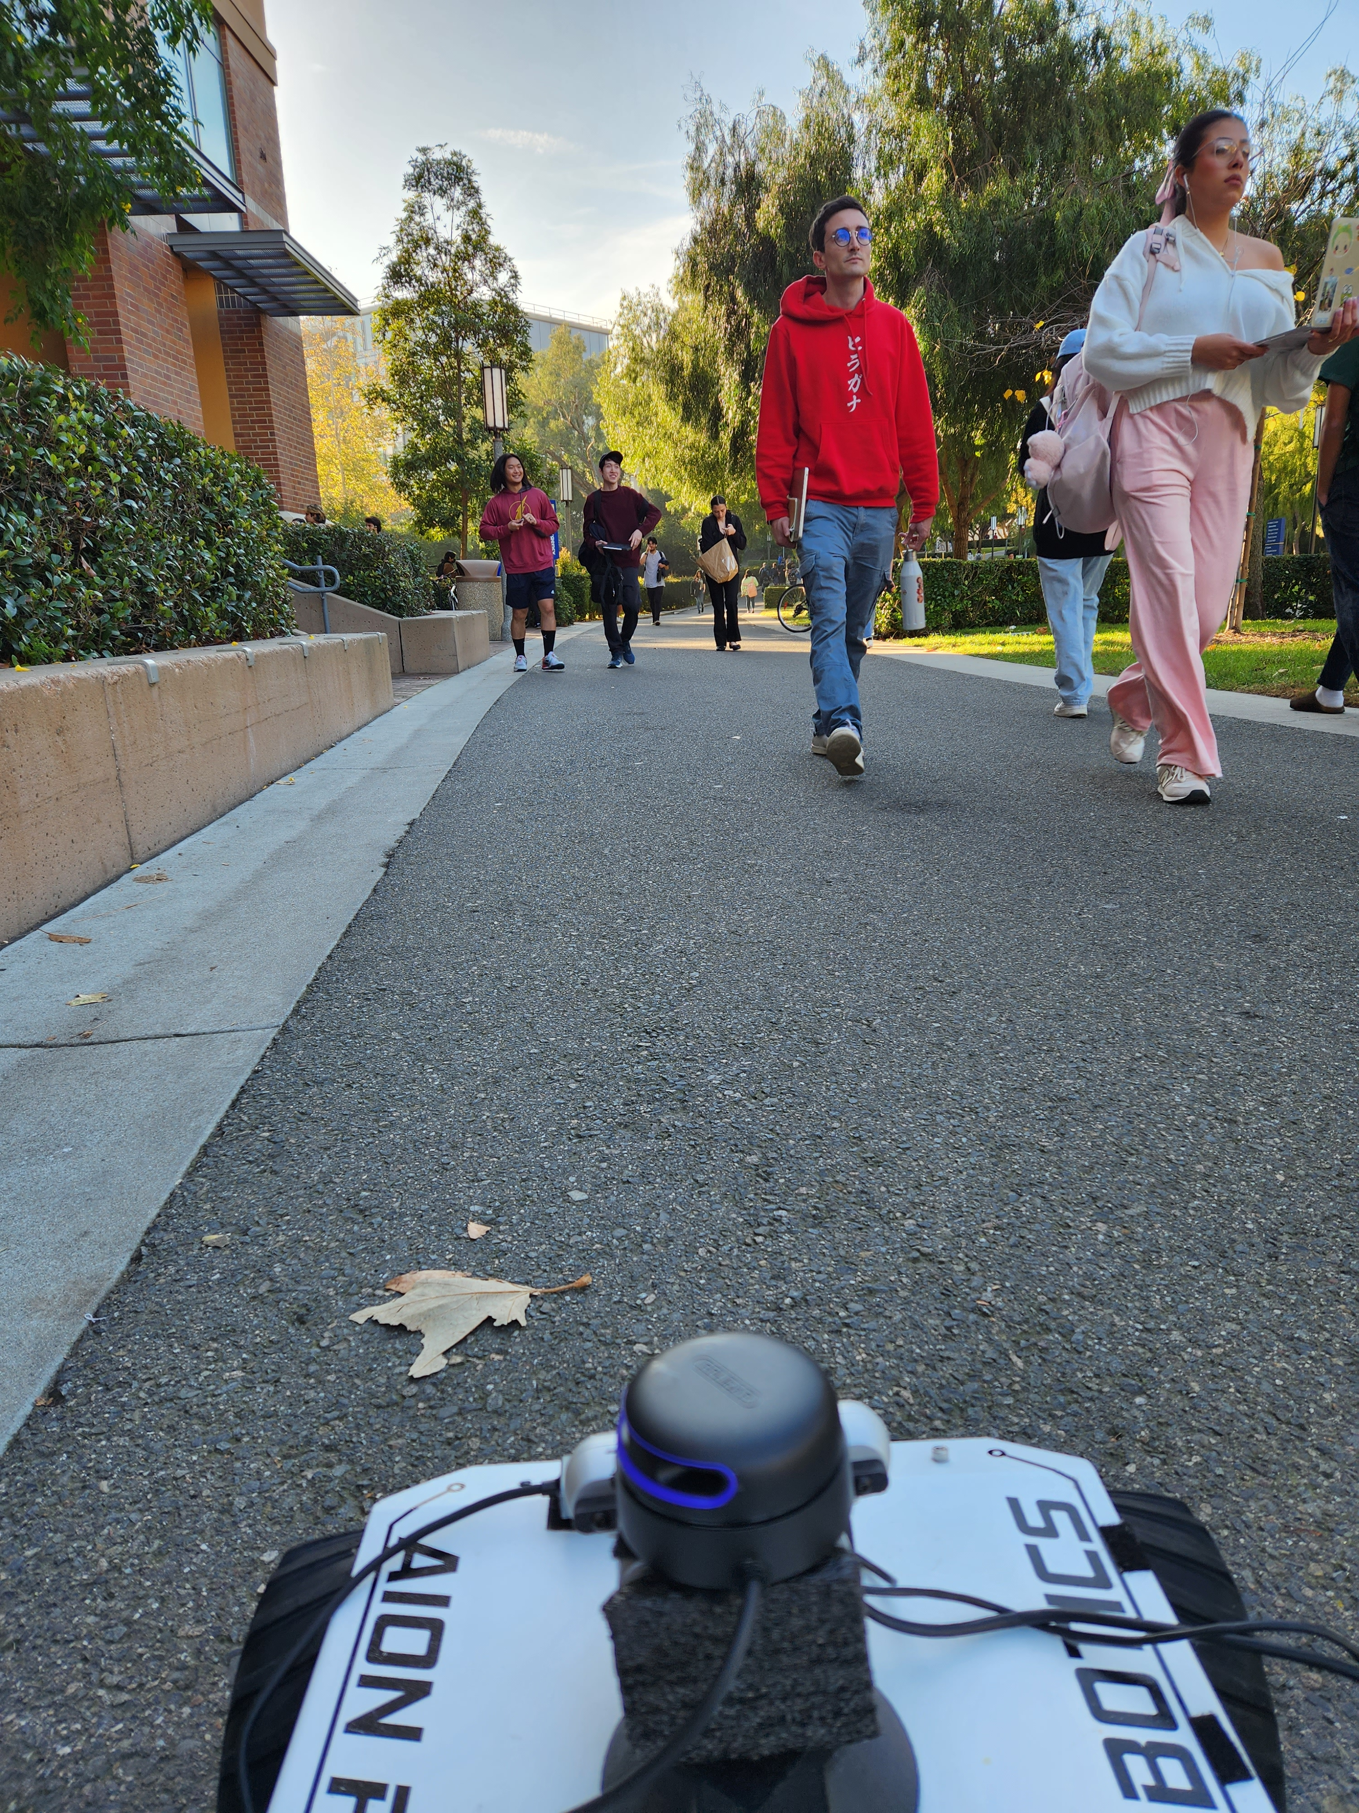
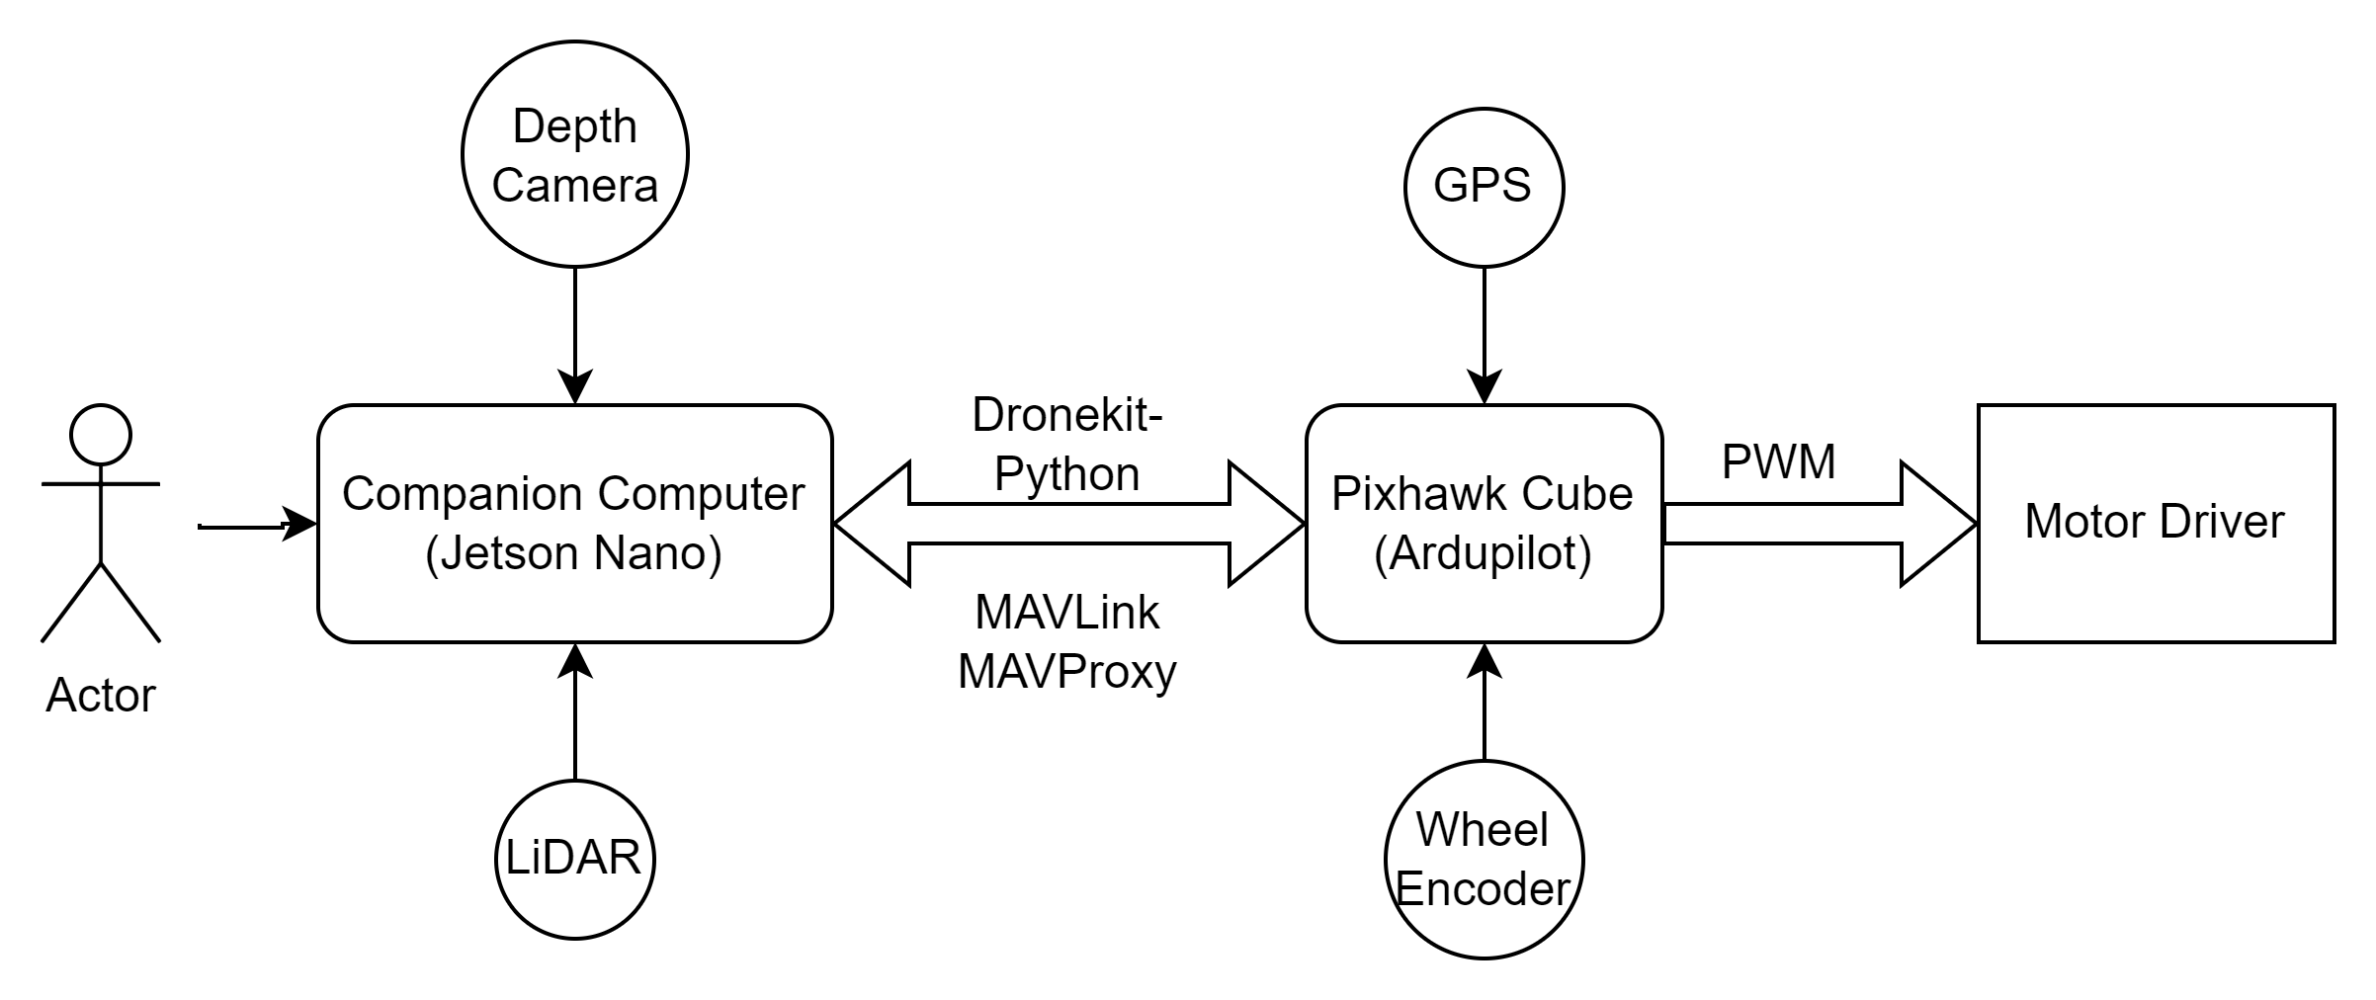
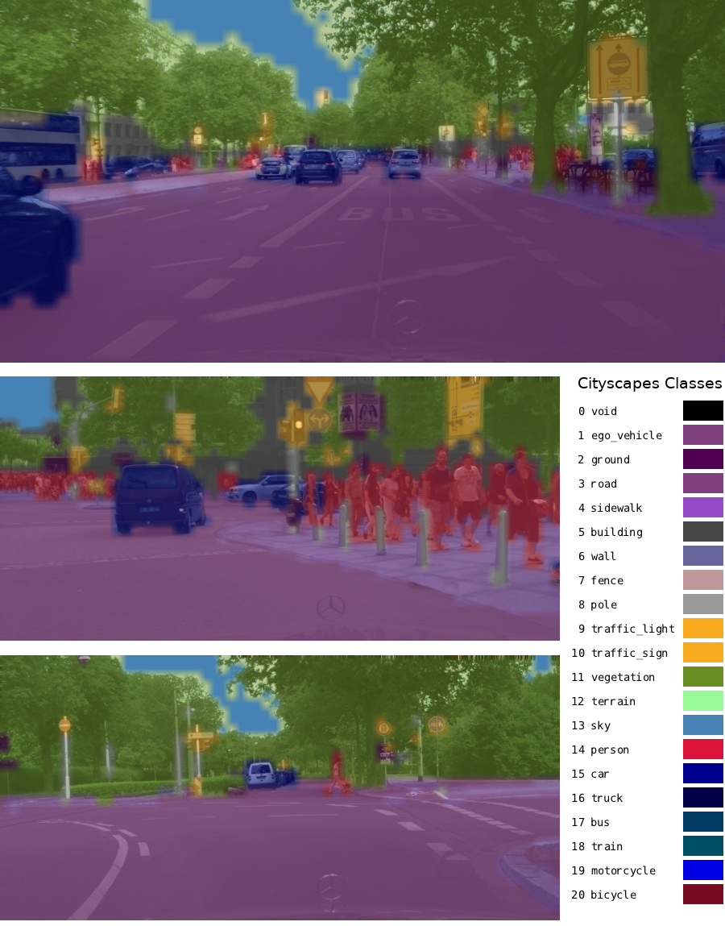
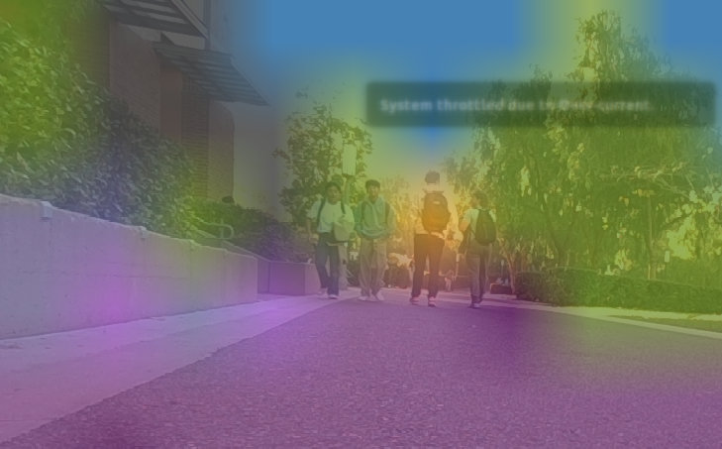
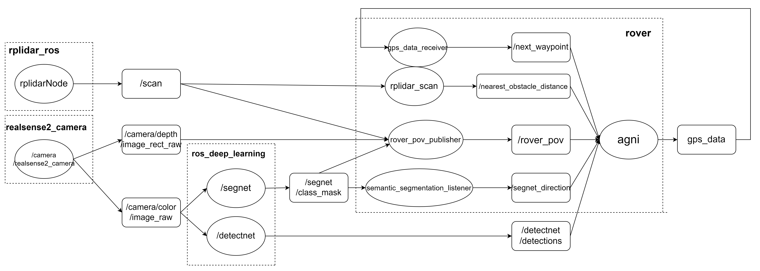
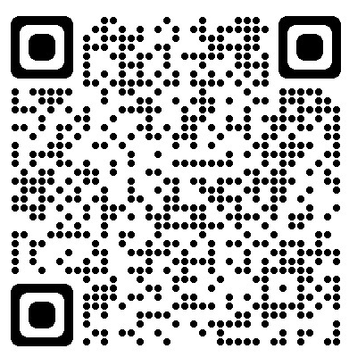
AGNI – Autonomous Ground Navigation Initiative
Bhumil Depani, Arjun Sivakumar, Ricky Bevan bdepani@uci.edu, sivakua2@uci.edu, babur@uci.edu Professor Marco Levorato, levorato@uci.edu Professional Master of Embedded and Cyber-physical Systems Program, University of California, Irvine
www.mecps.uci.edu
Abstract
Navigation Stack
The AGNI project aims to spearhead an open-source initiative revolutionizing robotics in autonomous navigation. By integrating rover and drone technologies, it tackles limitations each faces—rover navigates urban areas, while the drone handles inaccessible areas. This autonomous system leverages cutting-edge sensors, Jetson Nano's computing power, and ROS flexibility for robust environmental awareness. With a focus on localization, perception and mapping, it redefines navigation across cityscapes and challenging terrains, poised as a game-changer in diverse industries.
Map
AGNI leverages cutting-edge online mapping API, transforming geographical data into a dynamic roadmap. The API crafts an intelligent path based on the rover’s current and target locations, providing waypoints and navigation directions in real-time.
The AGNI
Key Technology
Traversable Path Planning
Local Path Planning
Curb Detection
Point Cloud Formation
Intent Prediction
Anomaly Detection
2D to 3D Point Cloud Projection
Sensor Fusion
LIDAR POINT
CLOUD
DEPTH
RAW IMAGE
Hardware
TRAFFIC
SIGN
DETECTION
Applications
Last-Mile Delivery
Agriculture
Surveillance and Security
Infrastructure Inspection
Environmental Monitoring
Search and Rescue Operations
Exploration and Mapping
SEMANTIC
SEGMENTATION
ROS Structure
Get Connected
References
1. ODS-Bot:Mobile Robot Navigation for Outdoor Delivery Services
2. https://www.openstreetmap.org
3. Vision Based Sidewalk Navigation for Last-mile Delivery Robot 4. https://github.com/dusty-nv/jetson-inference/tree/master
Did you like the project? Connect with us to explore a world of opportunities and experiences! Scan the QR code to know more about the technical aspects and to contribute to this amazing and growing open source project.
Notes:
1

Slide 2
AGNI – Autonomous Ground Navigation Initiative
Bhumil Depani, Arjun Sivakumar, Ricky Bevan bdepani@uci.edu, sivakua2@uci.edu, babur@uci.edu Professor Marco Levorato, levorato@uci.edu Professional Master of Embedded and Cyber-physical Systems Program, University of California, Irvine
www.mecps.uci.edu
Abstract
Navigation Stack
The AGNI project aims to spearhead an open-source initiative revolutionizing robotics in autonomous navigation. By integrating rover and drone technologies, it tackles limitations each faces—rover navigates urban areas, while the drone handles inaccessible areas. This autonomous system leverages cutting-edge sensors, Jetson Nano's computing power, and ROS flexibility for robust environmental awareness. With a focus on localization, perception and mapping, it redefines navigation across cityscapes and challenging terrains, poised as a game-changer in diverse industries.
Map
AGNI leverages cutting-edge online mapping API, transforming geographical data into a dynamic roadmap. The API crafts an intelligent path based on the rover’s current and target locations, providing waypoints and navigation directions in real-time.
The AGNI
Key Technology
Traversable Path Planning
Local Path Planning
Curb Detection
Point Cloud Formation
Intent Prediction
Anomaly Detection
2D to 3D Point Cloud Projection
Sensor Fusion
LIDAR POINT
CLOUD
DEPTH
RAW IMAGE
Hardware
TRAFFIC
SIGN
DETECTION
Applications
Last-Mile Delivery
Agriculture
Surveillance and Security
Infrastructure Inspection
Environmental Monitoring
Search and Rescue Operations
Exploration and Mapping
SEMANTIC
SEGMENTATION
ROS Structure
Get Connected
References
1. ODS-Bot:Mobile Robot Navigation for Outdoor Delivery Services
2. https://www.openstreetmap.org
3. Vision Based Sidewalk Navigation for Last-mile Delivery Robot 4. https://github.com/dusty-nv/jetson-inference/tree/master
Did you like the project? Connect with us to explore a world of opportunities and experiences! Scan the QR code to know more about the technical aspects and to contribute to this amazing and growing open source project.
Notes:
2

